Slide 1

Enterprise-Class
Email & Document Management
for SharePoint
  Trevor Dyck,
  Director, Product Management,
  Colligo Networks

Slide 2
Agenda
The Colligo Vision
Unified Solutions for Email & Records Management
  Colligo Email Manager
  Colligo Contributor Pro
  Colligo Briefcase
  Colligo Administrator
Key Strategic Partnerships
  GimmalSoft
  NewsGator

Slide 3
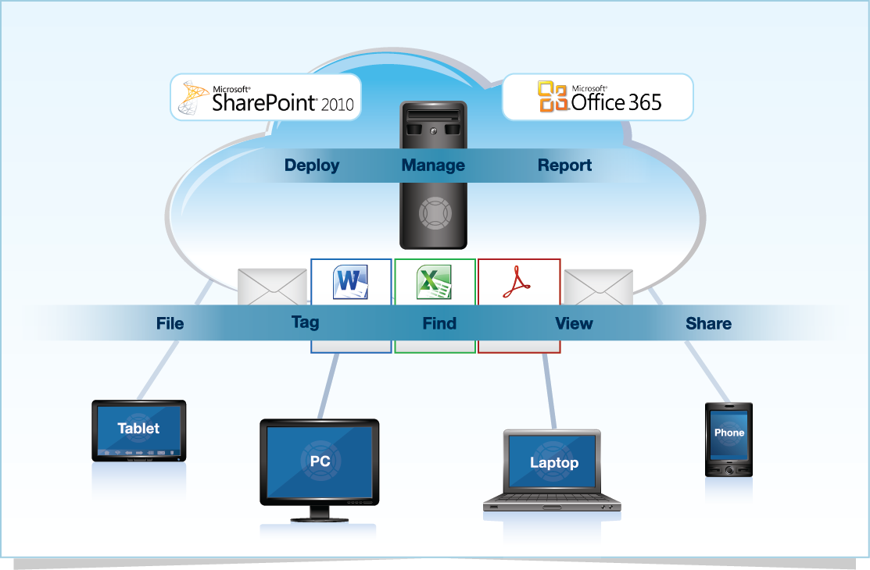
Built for the Enterprise

Slide 4
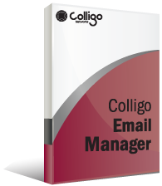
Colligo Email Manager
Scalable enterprise solution that integrates with Outlook to manage email and attachments in SharePoint 2010 & Office 365.
File, tag, find, view & share
Drag-and-drop email & attachments
Tag with extracted or custom metadata
Replace attachments with links
Search Outlook & SharePoint together

Slide 5
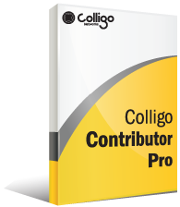
Colligo Contributor Pro
Windows desktop suite for offline document and email management
Manage email & attachments in SharePoint from Outlook
Manage SharePoint documents from the desktop using Windows File Explorer
Offline access to SharePoint content
Mobile email filing support from Windows Phone 7

Slide 6
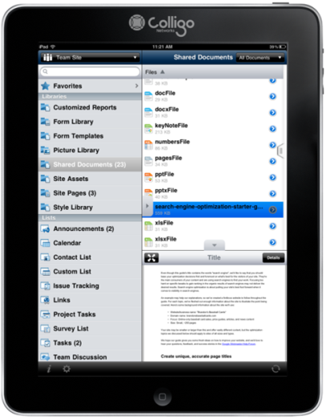
Colligo Briefcase
Access SharePoint content from the iPad; maintain control and security over corporate data.
View SharePoint content—no browser required
Automatic and manual sync for latest content
Search & favorites for quick access
Replace attachments with links
Hardware-based encryption, app-specific passcode, remote data wipe
Notes:
View documents, email, lists, images and other SharePoint content right in Colligo Briefcase
Sync to SharePoint for offline access to the latest content, allowing you to be productive without network access
Find the right content using Search and Favorites, improving user productivity
Share links to documents for easy collaboration and to help reduce duplication of content
Secure your enterprise content with hardware encryption, remote wipe, and passcode access

Slide 7

Colligo Administrator
Centralized configuration, management and reporting for Colligo desktop and mobile applications
Deploy – Central provisioning for mobile and desktop devices, on-premise or in the cloud
Manage - Easily configure access to required content, without requiring IT
Report – Detailed metrics on SharePoint & Colligo usage

Slide 8

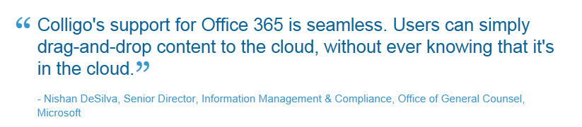
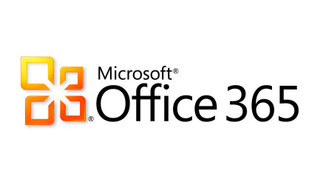

Slide 9
Benefits
Drive SharePoint engagement by removing technical
barriers
Increase productivity by letting people use they tools they know
Reduce corporate risk from litigation and ediscovery initiatives
Drive regulatory compliance through effective records management processes
Quickly & easily deploy every Colligo solution to the enterprise

Slide 10


Visit our Partners
Booth #330
Gimmalsoft Compliance Suite for SharePoint
The only DoD 5015.02-certified records management application built on SharePoint 2010
Integrates Colligo email management
Booth #365
Integrated email & social solution for the enterprise
Upload email & attachments to social communities
Transparently surface & target content in activity streams

Slide 11
Thank you!
Please visit us
for a demo at
Booth #709

