Slide 1
Creating SharePoint Adoption and Engagement
Robert Bogue
Rob.Bogue@SharePointShepherd.com
+1 (317) 844-5310
https://www.SharePointShepherd.com
Notes:
Time: 1 minutes
Todo:
Review Course from an adult learning perspective

Slide 2
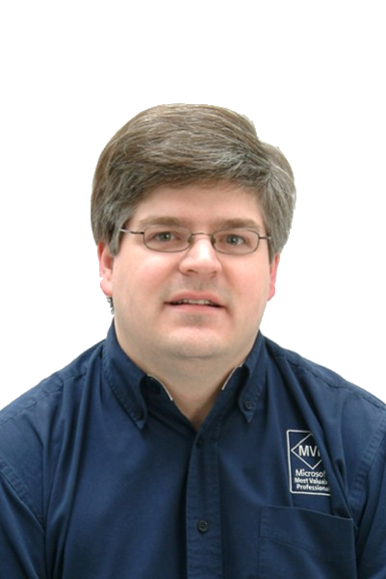
Who am I?
8 Time Microsoft MVP
Author of 22 books
Editor of over 100 more books
Architect
  Developer
  IT Professional
  Project Manager
Publisher
Notes:
Fun… Introverted

Slide 3

The SharePoint Shepherd’s Guide for End Users: 2010
Content
  Background Information
  Decision Trees
  181 Tasks
Available Forms
  Book (available where books are sold)
  Corporate Licenses available for deployment to your intranet.
Notes:
Why I did it… having trouble timing training and user need...

Slide 4
Is Adoption the Goal?
Adoption
Engagement
Simple to achieve – Simply force everyone’s home page to SharePoint.
Passive (Usage)
Difficult to achieve – You can’t force creation
Active (Creation)
Notes:
Time: 1.5 minutes
Set the home page to your intranet … 40% of all traffic to your home page may not hit another page on your Intranet

Slide 5
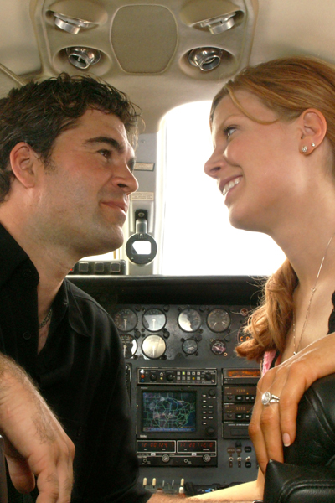
What is Engagement?
Engagement (noun) – the act of engaging or the state of being engaged.
  Dictionary.com
Engaged – busy or [fully] occupied; involved
  Dictionary.com
Notes:
Time: 1 minute
KEY: (Solution) Creation
Picture: Engagement photo I took of my brother and his now wife. For me, that’s engagement.

Slide 6
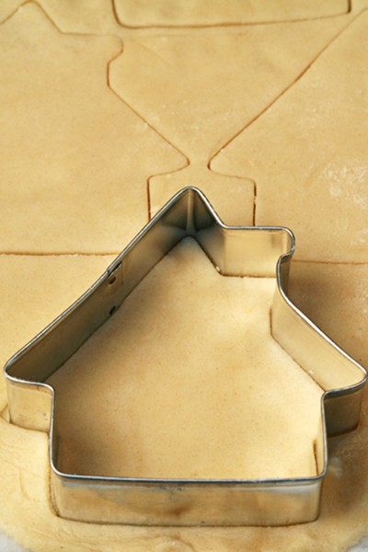
Cause and Effect
Adoption is initially easier to create than engagement – because it’s easier to teach
Adoption is the effect. Engagement is the cause. You can drive adoption (mimic the effect) but sustaining it takes more and more energy
Once solutions are created users will come
Notes:
Time: 1 minute
Story: Sub-Prime Mortgage Collapse
Economists knew that home ownership correlated to a more stable economy.
They incorrectly assumed that it CAUSED economic stability.
Laws and Policies were set in motion to create loans with lower and lower thresholds
When home prices dipped and interest rates climbed so did defaults
This caused a near meltdown in the financial industry (and the automotive industry)
The problem was they were driving the EFFECT and not the cause.

Slide 7
Change Management
“All things change – just not always the way we want.”
- A democrat
Notes:
Time: 0.5 Minutes

Slide 8
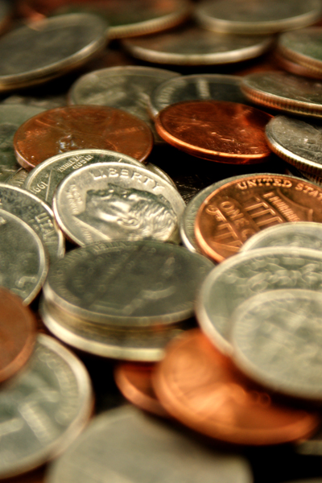
Creating Change
Models of Change
  Stages of Change
  Kurt Lewin (Freezing)
  John Kotter’s 8 steps
Understanding Motivation
  Autonomy
  Mastery
  Purpose
Notes:
Time: 0.5 Minutes
Note: Skipping Stages of Grief

Slide 9
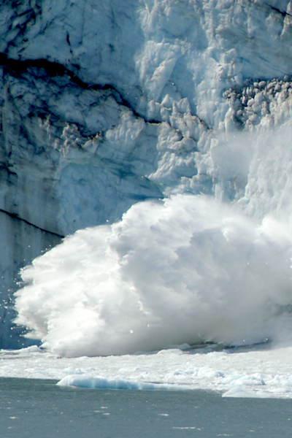
Kurt Lewin
Change as a Process
  Unfreezing
  Change and Transition
  Freezing
Behavior is a function of person and environment
  B = f(P, E)
Notes:
Time: 1.5 minutes
La VEEN
German-American Psychologist
Often we describe the environment we want – but really we need to be talking about the behaviors
Story: Popcorn Sales Communication
Plans…
Timeline
And it still didn’t work … we didn’t get the right behavior.

Slide 10
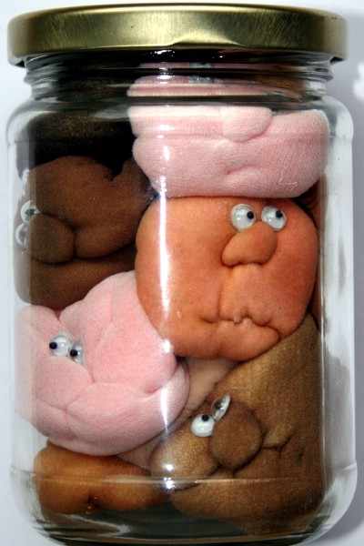
John Kotter’s 8 Steps
Create urgency
Form a powerful coalition
Create a vision for change
Communicate the vision
Remove obstacles
Create short-term wins
Build on the change
Anchor the changes in corporate culture
Notes:
Time: 1.5 minutes
Professor @ Harvard Business School
Core of this course is mapping SharePoint adoption to his change model

Slide 11
Motivation
“Beatings will continue until morale improves”
- Unknown Manager
Notes:
Time: 0.5 minutes

Slide 12
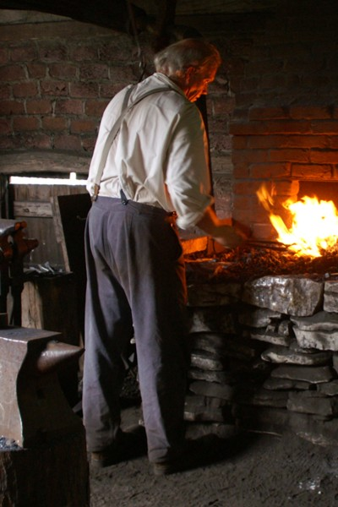
Motivation 3.0
1.0: Biology
2.0: Rewards and punishments
  Carrots and sticks
3.0: Intrinsic
  Autonomy
  Mastery
  Purpose
Notes:
Time: 2 minutes
Book Reference: Drive by Daniel Pink

Slide 13
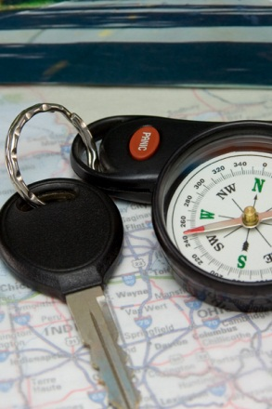
Autonomy
Self-Directed
Defining the DESTINATION = Ok
Defining the ROUTE to the DESTINATION = Not OK
Notes:
Time: 1 minute
Truck Driver – Paid by the mile, told where to deliver but not what roads to take (even though they’re paid off of optimal miles)

Slide 14
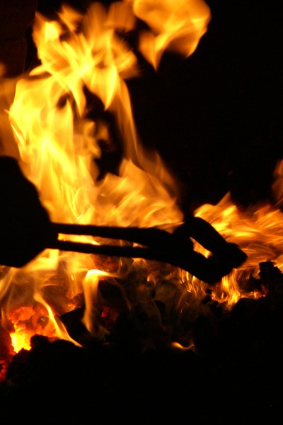
Mastery
Impossible goal
Ability to work towards being good at something
Notes:
Time: 1 minute
Asymptote – approaching (but never reaching) a line

Slide 15

Higher Purpose
Does what I’m doing matter?
  … to my development
  … to my career
  … to my family
  … to my world
Notes:
Time: 1 minute
Can be second chair… i.e. allowing someone else to reach their purpose
Supporting others is a noble purpose
Story: Ben Gibson
Teacher / Professor / Mentor
Wanted to help others reach their potential

Slide 16
Understanding Trust
“doveryai, no proveryai“
(Trust, but verify)
- Russian Proverb
Notes:
Time: 0.5 minutes
Building a Coalition
Enabling Action

Slide 17

Defining Trust
Trust - reliance on the integrity, strength, ability, surety, etc., of a person or thing; confidence.
Trusting is risky – and necessary
Reciprocal – I trust those who trust me.
  To be trusted I need to trust
Notes:
Time: 1.5 minutes

Slide 18
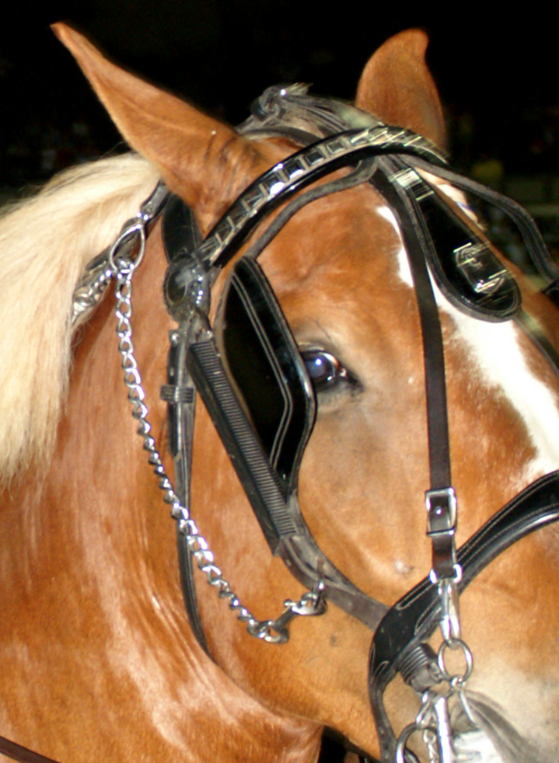
Components of Trust
Differentiate HOW and WHEN we trust
  Basic
  Blind
  Authentic
Types
  Contractual
  Communication
  Competence
Notes:
Time: 2 minutes
Building Trust in business, politics, relationships, and life – Robert Solomon, Fernando Flores
Trust and Betrayal in the Workplace – Dennis and Michelle Reina

Slide 19

Betrayal
Types
  Unintentional
  Intentional
When someone doesn’t behave consistently two or more of their values are in conflict.
Notes:
Time: 2 minutes
Image: Eggs Benedict… Benedict Arnold / Famous traitor of the American Revolutionary War

Slide 20
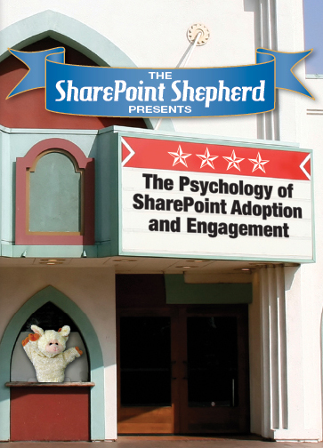
The Psychology of Adoption and Engagement
DVD format
2 hours and 21 minutes of content
It’s the “thinking” about adoption (and engagement)
This is a small slice of what’s in the DVD
Cost $249.99 from http://www.SharePoint Shepherd.com

