Slide 1

SharePoint Email Management for Law Firms and Legal Departments
Trevor Dyck
Director, Product Management
January 31, 2011
Notes:
1 : 20
1 : 1 Colligo

Slide 2







About Colligo
Focus: email management in SharePoint
  Powering the Electronic Matter File
About Colligo
  Founded: 2000
  Key partner: Microsoft
  250+ partners worldwide
Industry presence
  3,500+ customers in 55+ countries
  Multi-award winning software suite
  AMLAW100 customers
Notes:
1 : 21
1 : 2 Colligo

Slide 3
Email Management for Legal –
Solution Context
SharePoint 2010 allows you to simplify and manage all matter content on a single platform
Legal professionals live in Outlook and Word every day
Colligo provides a solution for capturing, retaining, and finding email and documents: SharePoint and Outlook integration
Together with SharePoint platform, provides a highly extensible solution:
  Workflow processes for specific practice groups
  Custom metadata and tagging
  Rules-based routing of content
Notes:
2 : 23
2 : 4 Colligo

Slide 4

Email Management for Legal
– Colligo Solution
Colligo provides the solution for capturing, tagging, retaining, and finding email in SharePoint
Colligo Contributor enables users to … | Drag-and-drop emails and attachments directly from Outlook to SharePoint Automatically capture email metadata View and access SharePoint content directly from Outlook, whether online or offline Automatically upload attachments to SharePoint when sending an email; file replaced with links in email Enjoy a familiar Outlook interface to SharePoint, with minimal retraining
Supports on-premise and cloud environments, e.g. BPOS/Office365 | Small footprint, client-only application Configurable deployment package and open API
Notes:
2 : 25
2 : 6 Colligo
Mention support for all versions of SP, Office and Windows

Slide 5
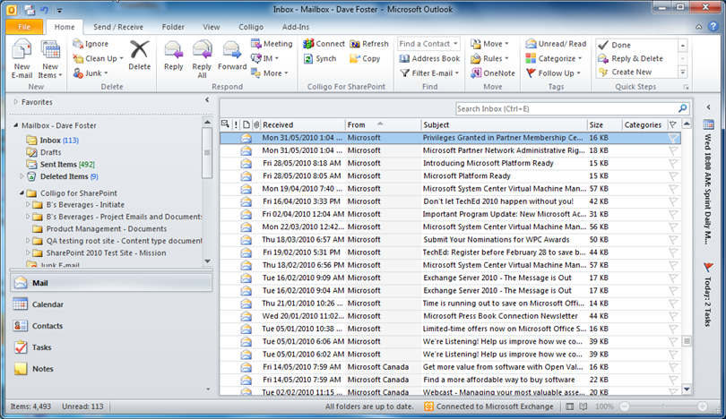
Colligo Contributor
Email Management for SharePoint
Drag & drop emails and attachments
to SharePoint folders
Colligo Contributor has driven better collaboration within our legal team because it ensures that all case-related emails and documents are easily uploaded to SharePoint, tagged with accurate metadata, and available both online or offline.
  – Adam Davidson, Solicitor, National Grid, U.K.
Notes:
1 : 26
1 : 7 Colligo

Slide 6
Scenario for Law Firms: Secure Extranet
“Simple and secure collaboration with clients via extranet”
Example scenario | Lawyer emails a contract to client, with link to attachment in SharePoint extranet (using Colligo ‘attachment manager’) Client securely opens document on extranet site, using their own unique credentials Client views documents directly in Office Web Apps in extranet environment
Benefits to the firm | Reduces risk of document going to wrong person or address Reduces amount of extended email traffic, back and forth sending of attachments, version tracking issues Single platform for document management and extranet lowers TCO Increases “stickiness” for clients
Notes:
2 : 28
2 : 9 Colligo

Slide 7
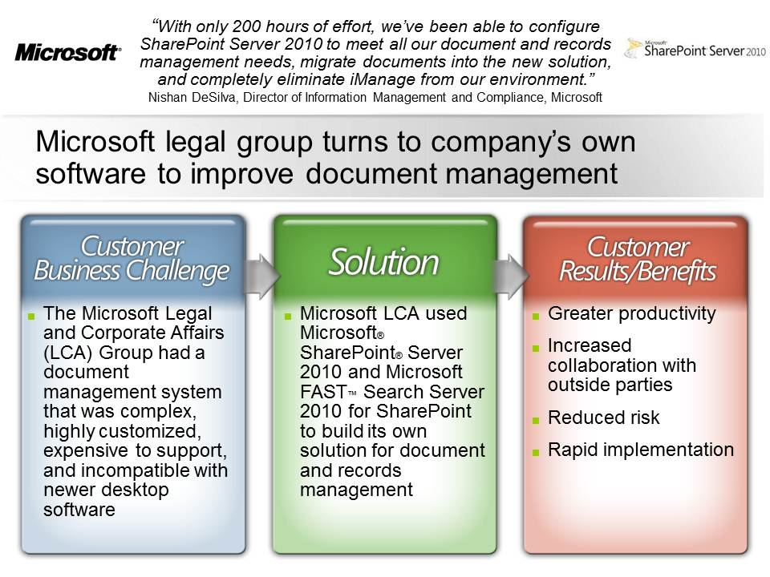

Case Study:
Microsoft Legal and Corporate Affairs (LCA)
Notes:
2 : 28
2 : 9 Colligo

Slide 8
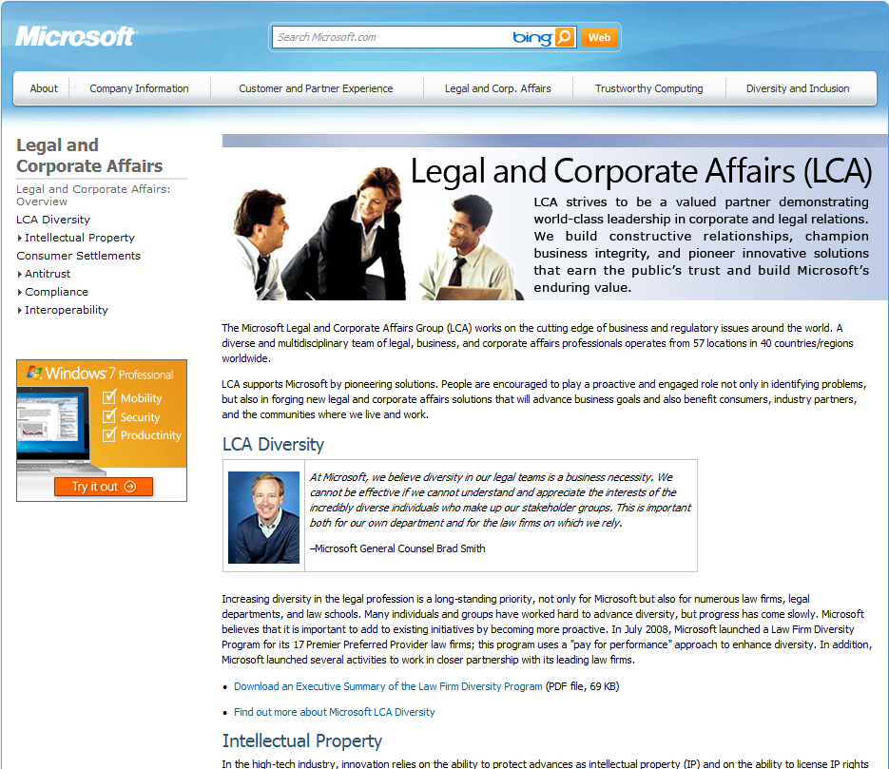
Case Study: Microsoft LCA
The Microsoft Legal and Corporate Affairs (LCA) Group consists of 987 attorneys, paralegals, and business professionals
Notes:
1 : 29
1 : 10 Colligo

Slide 9
LCA: Challenge
LCA had a document management system that was complex, highly customized, expensive to support, and incompatible with newer desktop software
Utilize SharePoint 2010 to deliver a compliance-driven document, records, and contract management solution that contains flexible taxonomies which correspond to practice-level work
Objective
Notes:
1 : 30
1 : 11 Colligo

Slide 10
LCA: Solution
Microsoft LCA used Microsoft SharePoint Server 2010 and Microsoft FAST Search Server 2010 for SharePoint to build its own solution for document and records management
Flexible information-tagging taxonomies correspond to practice-level work
Search experience tailored to the needs of its legal practitioners
Practitioners use Colligo Contributor to access, capture, and tag content contained in SharePoint from within Microsoft Outlook 2010
Practitioners use Colligo to drag email and attachments from Outlook into SharePoint Server → Ease of use and higher adoption
Notes:
1 : 31
1 : 12 Colligo

Slide 11

LCA: Benefits
Greater productivity
Increased collaboration with outside parties
Reduced risk
Rapid implementation (under 200 hours)
Successfully replaced Autonomy’s iManage
More details available
Microsoft Case Study
http://www.microsoft.com/casestudies/Microsoft-Office-Professional-2010/Microsoft/Microsoft-Legal-Group-Turns-to-Company-s-Own-Software-to-Improve-Document-Management/4000008264
Colligo Recorded Webinar: http://www.colligo.com/Webinars/2010MicrosoftLCA/Webinar/play.html
Notes:
1 : 32
1 : 13 Colligo
Productivity: finding docs (one click access to recently used), doc IDs, search, std templates w default metadata
Risk: reduced because the platform is used => access control, retention policies, enforced tagging
Rapid implementation: under 200 hours; largely out of the box → very impressive

Slide 12
Business Value
Simplicity
One place to go for project content and collaboration across geos
Productivity
Quality
Improved findability and relevance (less “GIGO”)
Effective management of information assets in email
Reuse
Consistency
One repository policy improves records compliance
Access control, retention policies, enforced tagging
Reduced risk
Familiarity
Minimal change → low project risk, high user adoption
Expanded SharePoint adoption drives ROI
Adoption
Notes:
1 : 33
1 : 14 Colligo
Productivity: Finding documents (one click access to recently used), search, standard templates with default metadata
Risk
Simplicity = Tactical practice managers
Quality = Strategic Value = CKO
Consistency = Regulatory Value = General Counsel
Familiarity = Risk Management & Financial Value = All execs
Manage and access all SharePoint content via the Outlook interface ➔ less context shifting, saves time and keystrokes
Reduce IT complexity and cost by leveraging SharePoint to eliminate multiple systems and centralize project information
“Make your users champions”
Use Dynamics example

Slide 13

Testimonials from Law Firms
The Colligo Contributor Add-In provides an excellent solution for email management in SharePoint… It enables us to fully utilize SharePoint to centralize case data and because it’s so easy to add emails and files to SharePoint, our Practice Center is growing with well-indexed documents that are easy to find and share.
  – Israel Fischer, Partner, Fischer Behar and Co.
“By extending the capabilities of Microsoft BPOS with Colligo Contributor Pro, we have not only replicated, but surpassed, the functionality of Interwoven FileSite, and have done it in a way that
is much more cost-effective and easy to manage.”
– Brandon Fernald, Principal, Fernald Law Group
Notes:
1 : 34
1 : 15 Colligo

Slide 14
Next Steps
Access Resource Center for White Papers and Case Studies
Try SharePoint Email Management Solutions
Request a Demo
www.colligo.com
Colligo Sales
1-604-685-7962 ext 230
sales@colligo.com
Notes:
1 : 35
1 : 16 Colligo

