Slide 1
Effective Email Management in SharePoint 2010

Slide 2







About Colligo Networks
  Multi-award winning Colligo Contributor solution suite for email management in SharePoint
  3500+ customers in 55 countries
  Multiple enterprise deployments in Global and Fortune 500
  Founded in 2000; dedicated to SharePoint since 2004
  Key partner is Microsoft; 250+ regional solution partners

Slide 3





























Select Customers
3500+ customers in 55 countries

Slide 4
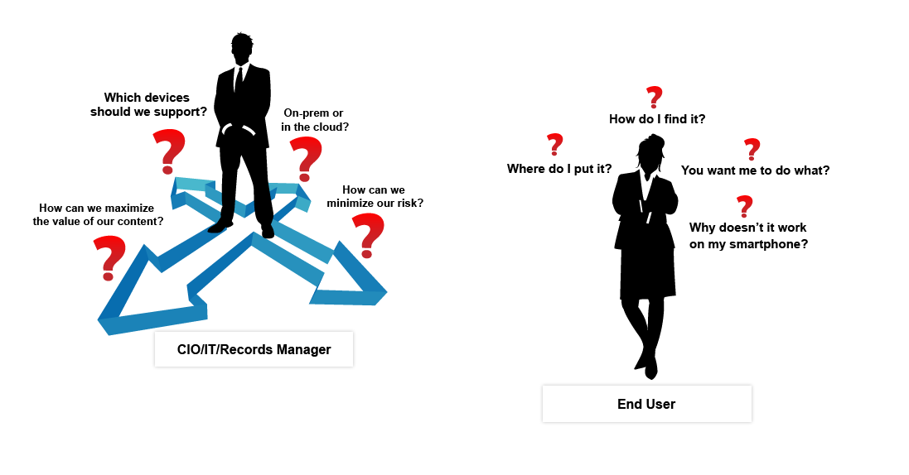
Email Management Challenges

Slide 5
Why Manage All Content?
Reduce Risks
Records retention and eDiscovery
Share Knowledge
Transparent collaboration
Drive Efficiencies
Reduce duplication
Information governance
Flexible taxonomies and smart tagging
Federated search
Compliance
Reduce overall storage expense
Reduce time to find information

Slide 6
Effective Email Management
Capture
Single instance of content
Tag
Find
Search on business taxonomies, organization taxonomies and records management
Consistent classification framework
Governed and managed sites and content
Access to relevant content when and where it is required

Slide 7

Colligo Contributor Pro
Captures More Emails and Attachments
  Several methods to easily move content to SharePoint
  Send & File: File to SharePoint on sending email
Encourages Use of SharePoint
  Access SharePoint within Outlook – no context shifting
  Attachment management
  SharePoint search in Outlook
  Offline access to SharePoint
Supports Compliance / Governance Goals
  Standardized content type and metadata capture
  Automatic capture of email properties to metadata
  Seamless record declaration from within Outlook

Slide 8
Capabilities of Colligo Contributor
SharePoint search in Outlook
Automatically capture email metadata
Manage SharePoint through Outlook
Drag-and-drop emails to SharePoint
Move/copy using Outlook rules or Quick Steps
Single-click send and file in SharePoint
Replace attachments with SharePoint links
Apply custom and managed metadata
Offline caching of SharePoint content
Select content type
View SharePoint in Outlook or Windows Explorer
File from mobile devices or OWA
Mark as filed
Find
Tag
Capture

Slide 9
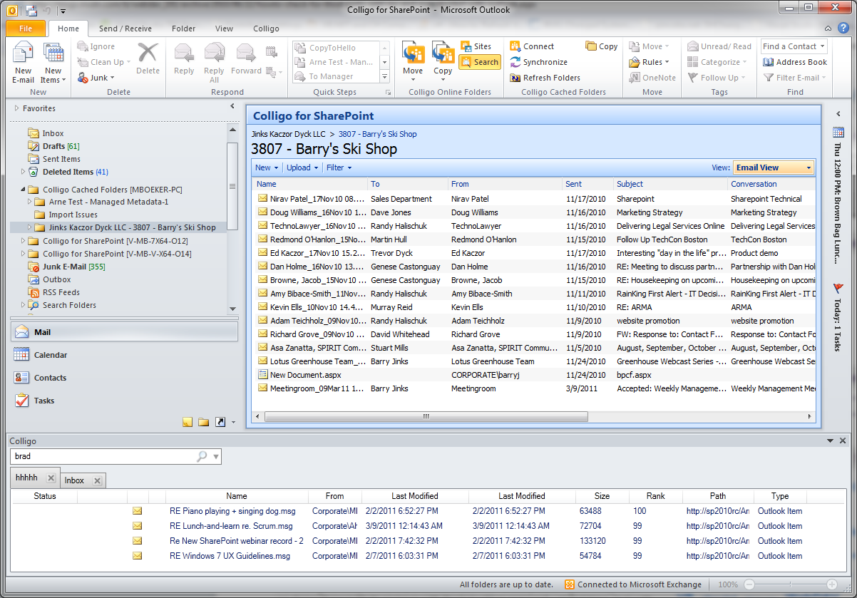
Capture – Browse - Search
SharePoint Lists and Libraries in Outlook folder tree
Copy Outlook folders, or move emails by drag-and-drop, Outlook rules, or Quick Steps
Online or offline view of SharePoint in Outlook
Federated search of SharePoint (native or FAST) and Outlook, then attach results as links

Slide 10
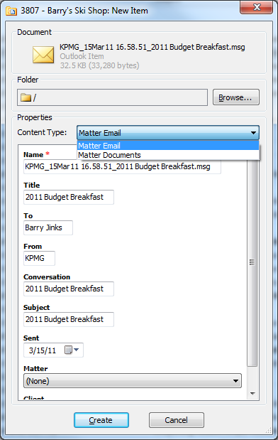
Tag - Edit
Select content type
Automatic extraction of email properties to SharePoint metadata
Set custom properties (including enterprise managed metadata)
Supports development of custom metadata editors

Slide 11
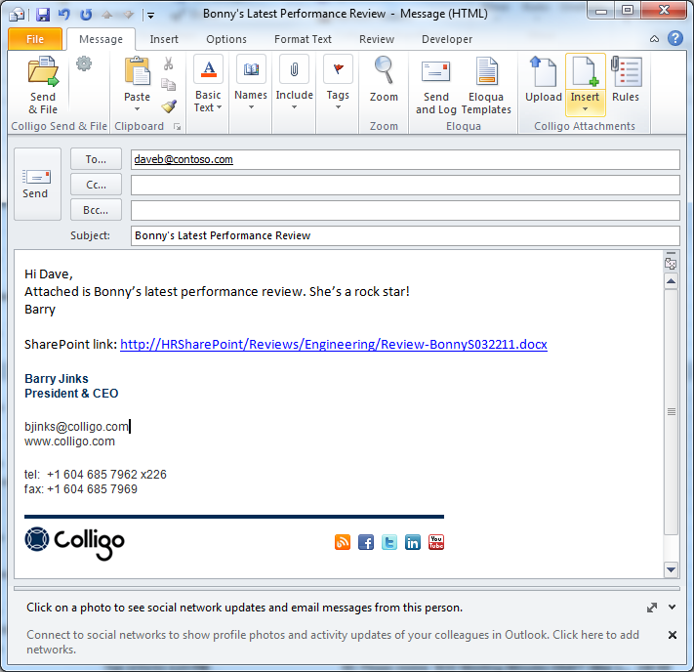
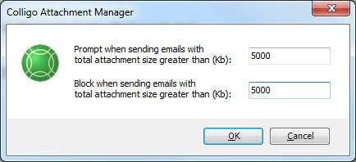
Auto Filing – Attachment Management
Colligo Attachment Manager
Send & File
Standard or custom attachment rules

Slide 12
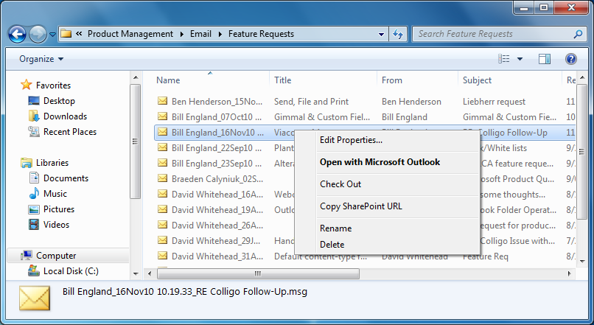
Windows Explorer Integration
Drag-and-drop from desktop or Outlook to SharePoint
Columns from default SharePoint view
SharePoint content accessible online or offline
Edit metadata and perform SharePoint functions within Windows Explorer

Slide 13
Windows Explorer Integration
    Proven reliable in 1000s of deployments
    Supports on-prem and cloud
    (Office 365-ready)
    Multi-language support
    File from mobile devices or OWA
    SKD for custom application development
    Automated deployment and admin tools
    Supports Office/SharePoint 2003/07/10
    Support virtualized environments

Slide 14




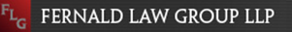
Featured Case Studies
Microsoft Legal and Corporate Affairs
Video Case Study: Microsoft Legal and Corporate Affairs
Microsoft Legal and Corporate Affairs Group improves document and records management with SharePoint 2010 and Colligo Contributor Pro
Webcor Builders
Webcor Builders improves email management with Colligo Contributor Uploader
Watson Wyatt
Video Case Study: Watson Wyatt
Global HR firm improves enterprise records management with Colligo Contributor
Morris - Depew Associates
Engineering firm goes paperless and improves email management with SharePoint and the Colligo Contributor Add-In for Outlook
Fernald Law Group (BPOS)
Creating competitive advantage with Microsoft
hosted SharePoint & Colligo Contributor Pro

Slide 15





Email Management Resources
SharePoint 2010 – What’s New for Email Management
Ryan Duguid, Senior Product Manager
How SharePoint 2010 Changes the Metadata Game
Dan Kogan, SharePoint Senior Program Manager
Is SharePoint 2010 Ready for Enterprise Content Management
Trisha Bush, Director, SharePoint Enterprise Business
How Microsoft is Using SharePoint 2010 & Colligo for ECM & Records Management
Nishan DeSilva, Director, Information Management & Corporate Compliance
Best Practices for Project & Email Management in SharePoint for Architecture, Engineering & Construction Firms
Marc Beckmann, ProServ Industry Manager

Slide 16



Additional Webinars
On-demand Webinars:
How to Implement an Effective Email Attachment Solution in Sharepoint
Eric Legault, MVP, Consultant & Author
Best Practices for Using SharePoint for Email Management
Kathy Hughes, Microsoft MOSS MVP
White Papers:
Developing an Effective Email Management Solution in SharePoint
Requirements and strategies for a successful implementation
Colligo’s SharePoint Client Solutions for Law Firms and Legal Departments
How Colligo Contributor powers the electronic matter file

Slide 17


More Information
Try Colligo Contributor
  30-day trials for Contributor solution suite:
  www.colligo.com
Visit the Colligo Resource Center
  Information on email management in SharePoint
  White papers, case studies, on-demand webinars
  www.colligo.com/resources
Contact Us
Bill England, Director, Business Development
+1.604.307.2341
bengland@colligo.com

